Slide 1

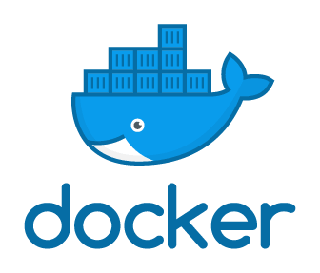
(BCSE 0510) Container Orchestration and Infrastructure Automation
How Docker Works?
Lecture: 2

Slide 2
AGENDA
Workflow of Docker
Docker Images
Docker Containers
Docker Hub

Slide 3
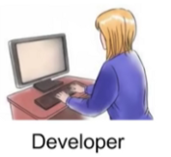
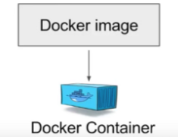
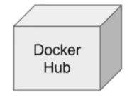


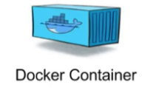
GENERAL WORKFLOW OF DOCKER

Slide 4
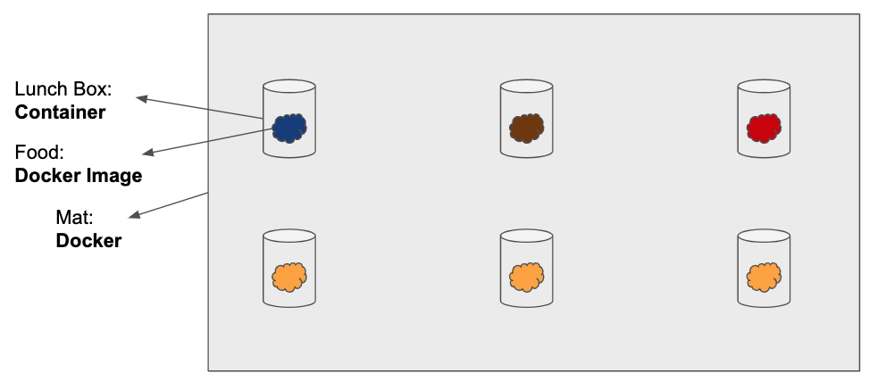
DOCKER IMAGES, CONTAINERS

Slide 5
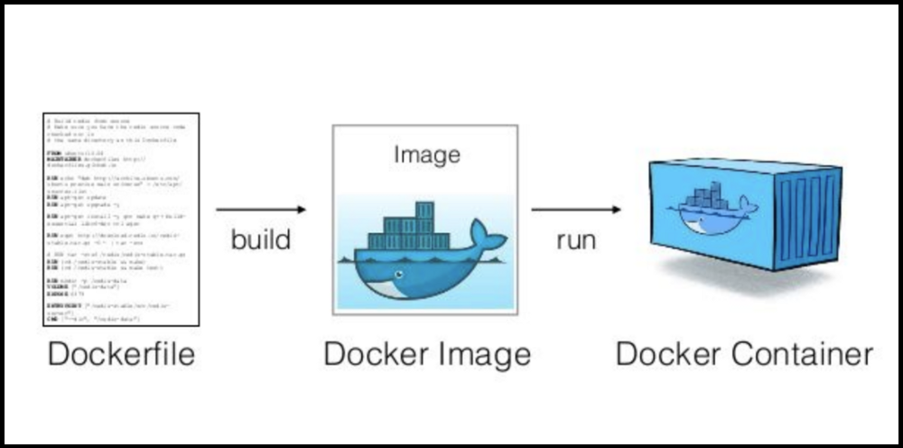
DOCKER FILE

Slide 6
DOCKER FILE
A developer will define all the dependencies and its requirements in a file which is called docker file.
This file can be used to create docker images.

Slide 7
DOCKER IMAGES
In a docker image you will have all the applications, its requirements & dependencies.
Docker file describes steps to create a docker image. Its like a recipe with all ingredients and steps necessary in making dish.

Slide 8
DOCKER CONTAINERS
Container will have applications with all its dependencies.
And when you run a docker image you get docker containers.

Slide 9
DOCKER HUB
Docker containers are the run time instances of docker image and these images can also be stored in an online cloud repository which is called as docker hub.
https://hub.docker.com/

Slide 10
TEST ENVIRONMENT
If you go to docker hub you will find a lot of publicly available images.
And you can store your own docker image as well you can also store your docker image in your own repository or version control system.
These images can be pulled to create containers in any environment so you can create a docker container in a test environment or on any other environment and we can be sure that our application will run in the same way using docker containers.

Slide 11
ADVANTAGES OF DOCKER
Docker enables more efficient use of system resources.
Docker enables faster software delivery cycles.
Docker enables application portability.
Docker shines for micro-services architecture.

Slide 12
ADVANTAGES OF DOCKER
Lighter weight: Unlike VMs, containers don’t carry the payload of an entire OS instance.
Greater resource efficiency: With containers, you can run several times as many copies of an application on the same hardware as you can using VMs.
Improved developer productivity: Compared to VMs, containers are faster and easier to deploy, provision, and restart.

Slide 13
WHY USE DOCKER?
Improved and seamless portability
Even lighter weight and more granular updates
Automated container creation
Container versioning
Container reuse
Shared container libraries

Slide 14


